Slide 1
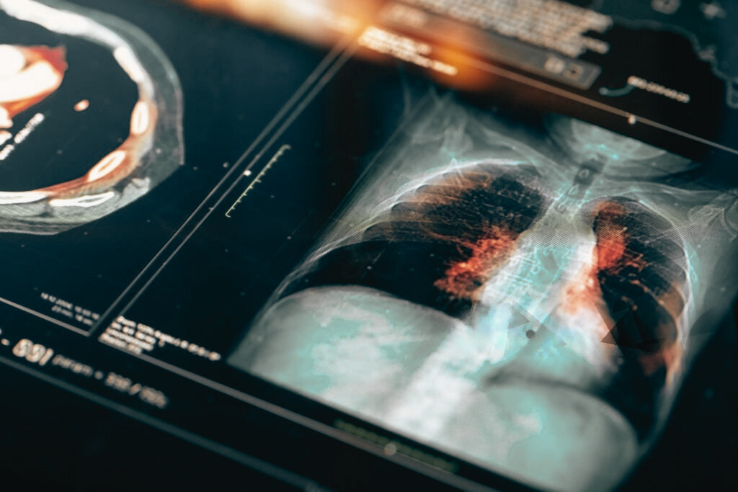

22-03-2024
DEEP LEARNING FOR PNEUMONIA DETECTION
DSPT05 GROUP 15

Slide 2
TABLE OF CONTENTS
I
II
III
IV
Problem Statement
Objectives
The Process
Model Evaluation
DSPT05 GROUP 15

Slide 3


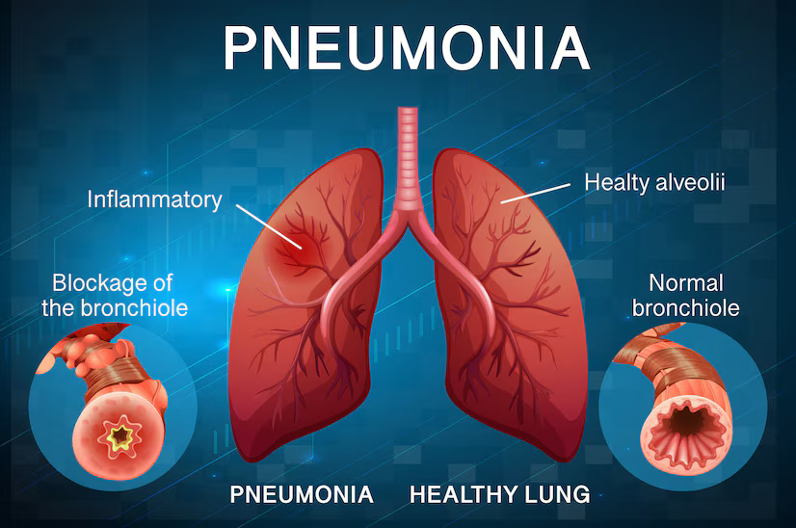



PROBLEM STATEMENT
RESULTS EVALUATION
Pneumonia is a serious respiratory illness, especially affecting vulnerable groups.
Current diagnosis methods have limitations:
Time delays
Subjectivity
Dependence on specialized expertise
Urgent need for faster, objective, and accessible diagnostic tools.
The Research questions are as follows:
Best deep learning model for pneumonia detection accuracy?
Transfer learning's effect on pneumonia detection?
Model vs. radiologist performance: clinical relevance?
DSPT05 GROUP 15

Slide 4



OBJECTIVES
01
Develop an automated system for pneumonia identification using deep learning techniques.
02
Train the system to detect pneumonia from chest X-ray images.
03
Validate the system's performance against current diagnostic methods.
DSPT05 GROUP 15

Slide 5
THE PROCESS
RESULTS EVALUATION
The research process was generally divided into 3 sections:
Exploratory Data Analysis & Preprocessing
Modeling
Results Evaluation
MODELING
Compared model performance using metrics such as accuracy and loss on test results
EDA & DATA PREPROCESSING
Developed and trained various Deep Learning algorithms to detect pneumonia cases from chest x-rays
Initial analysis to understand data distrubution and classes as well as to prepare it for modeling
DSPT05 GROUP 15

Slide 6





MODELING
RESULTS EVALUATION
In the modeling phase, various deep learning models were developed and trained using the preprocessed data.
MODELING
Compared model performance using metrics such as accuracy and loss on test results
01
Baseline CNN Model
02
Tuned Baseline CNN Model
EDA & DATA PREPROCESSING
Developed and trained various Deep Learning algorithms to detect pneumonia cases from chest xrays
03
Different Architecture CNN
04
ResNET50V2 Model
Initial analysis to understand data distrubution and classes as well as to prepare it for modeling
DSPT05 GROUP 15

Slide 7

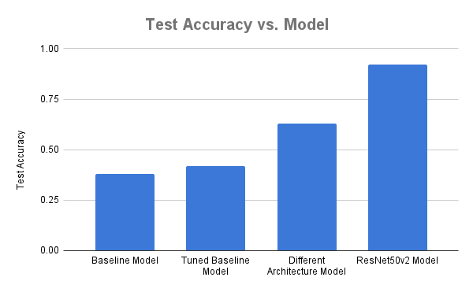
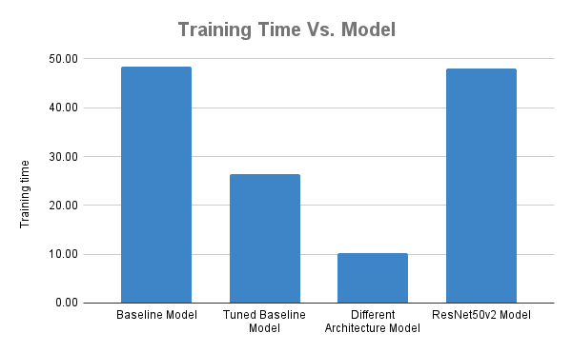
MODEL RESULTS
Accuracy:
Baseline Model: 38%
Tuned Baseline Model: 42%
Different Architecture Model: 63%
ResNet50v2 Model: 92%
Training Times:
Baseline Model: 48.40 mins
Tuned Baseline Model: 26.45 mins
Different Architecture Model: 10.25 mins
ResNet50v2 Model: 48 mins
60%
Average Human Radiologist Accuracy

Slide 8

COMPARATIVE ANALYSIS
SN.NO | Model Name | Model Architecture | Hyperparameters | Training Time | Validation Accuracy | Test Accuracy | Test Loss
1 | Baseline Model | CNN with original architecture | Adam optimizer, lr=0.001 | 48.40 mins | 0.50 | 0.38 | 172.32
2 | Tuned Baseline Model | CNN with original architecture | Adam optimizer, lr=0.001, early stopping | 26.45 mins | 0.56 | 0.42 | 40.07
3 | Different Architecture Model | CNN with modified architecture | Adam optimizer, lr=0.001, early stopping | 10.25 mins | 0.45 | 0.63 | 19.45
4 | ResNET50v2 Model | Pretrained ResNet50v2 | Adam optimizer, lr=0.0001 | 48 mins | 0.88 | 0.92 | 0.23
DSPT05 GROUP 15

Slide 9

RECOMMENDATIONS
While the results from the models are promising, there can be further improvements to get the
most accurate diagnoses using deep learning:
Validation: Validating the developed model through clinical trials is needed to ensure its reliability for diagnoses.
Deployment: Focus on creating a system that functions effectively with limited computational resources.
Accuracy: Further optimization of hyperparameters such as dropout rate and batch size to enhance model performance.
DSPT05 GROUP 15

Slide 10

DSPT05 GROUP 15

Slide 11

THANK YOU!
PRESENTED BY:
JOYLEEN CHERONO
Allan Eshitera
Johnmark Kibui
Andrew Maina
Colins Wanjao

